Slide 1
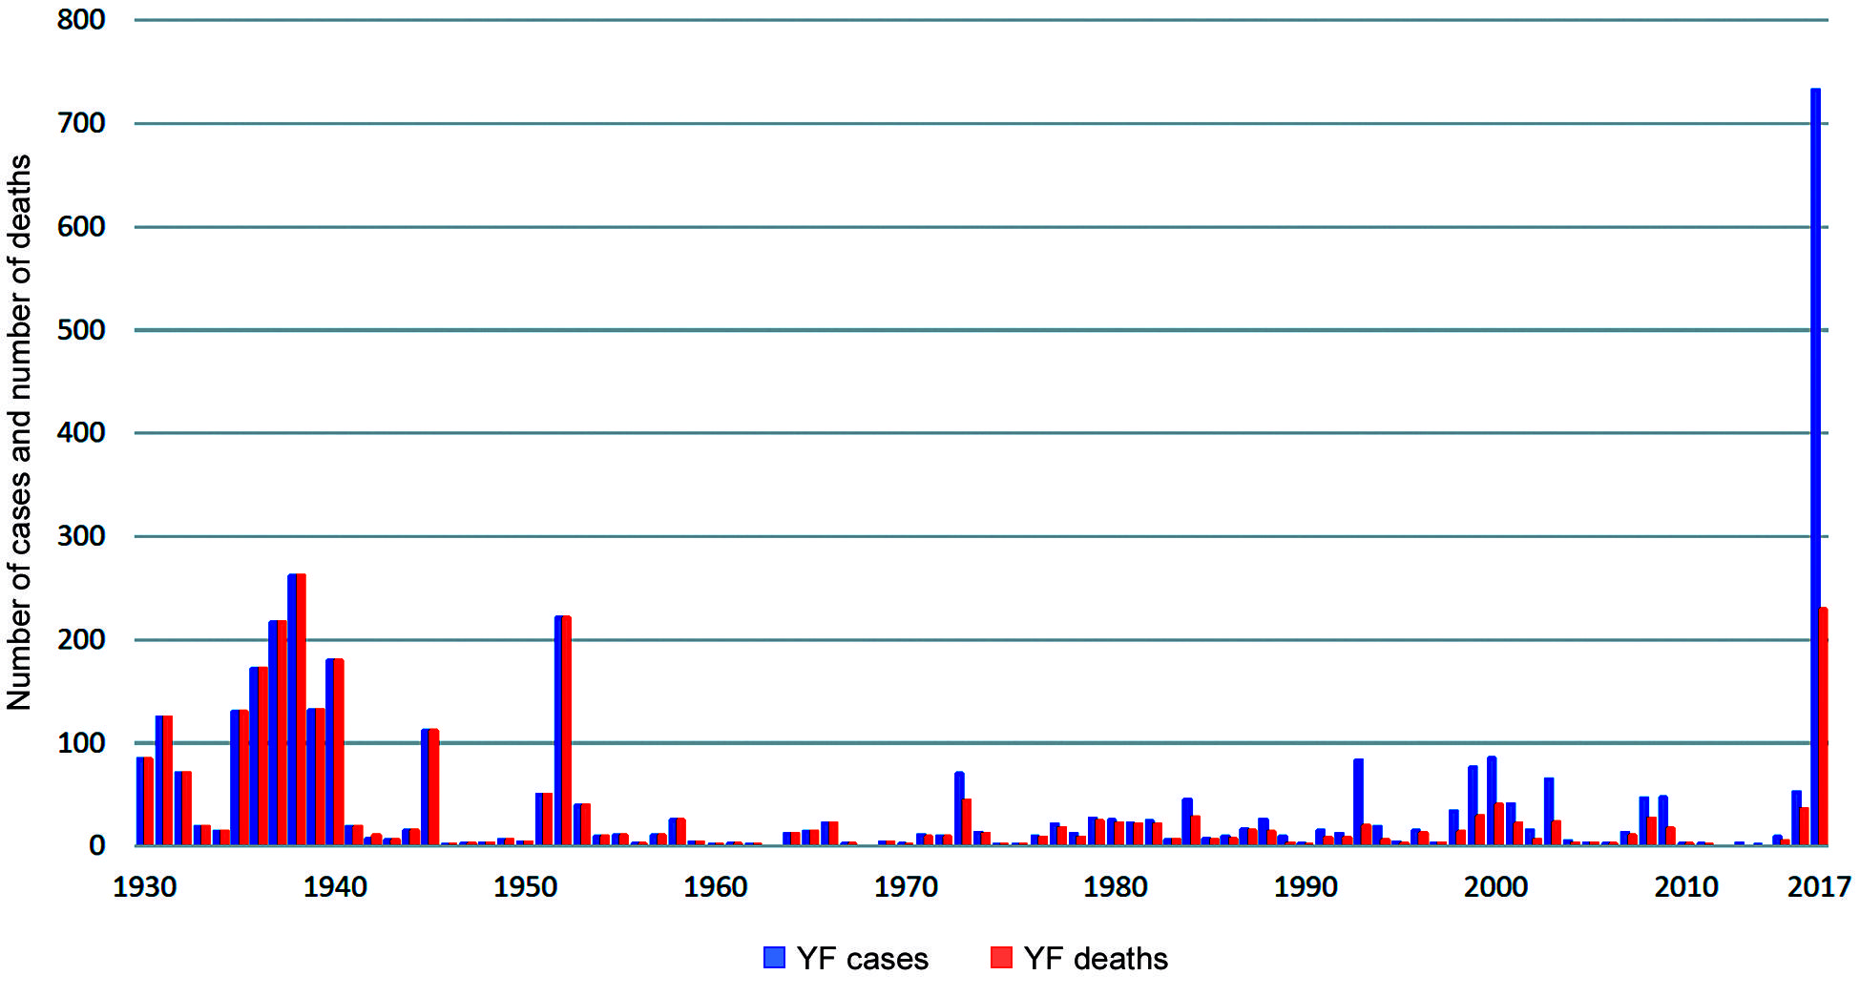

Sarah Guth University of California, Berkeley
Acknowledgments: Cara Brook, Soa Fy Andriamandimby
Background:
Yellow fever, dengue, chikungunya, and Zika viruses circulate in the Brazilian human population.
Yellow fever established a primate transmission cycle – we’re concerned the other viruses will do the same.

Slide 2
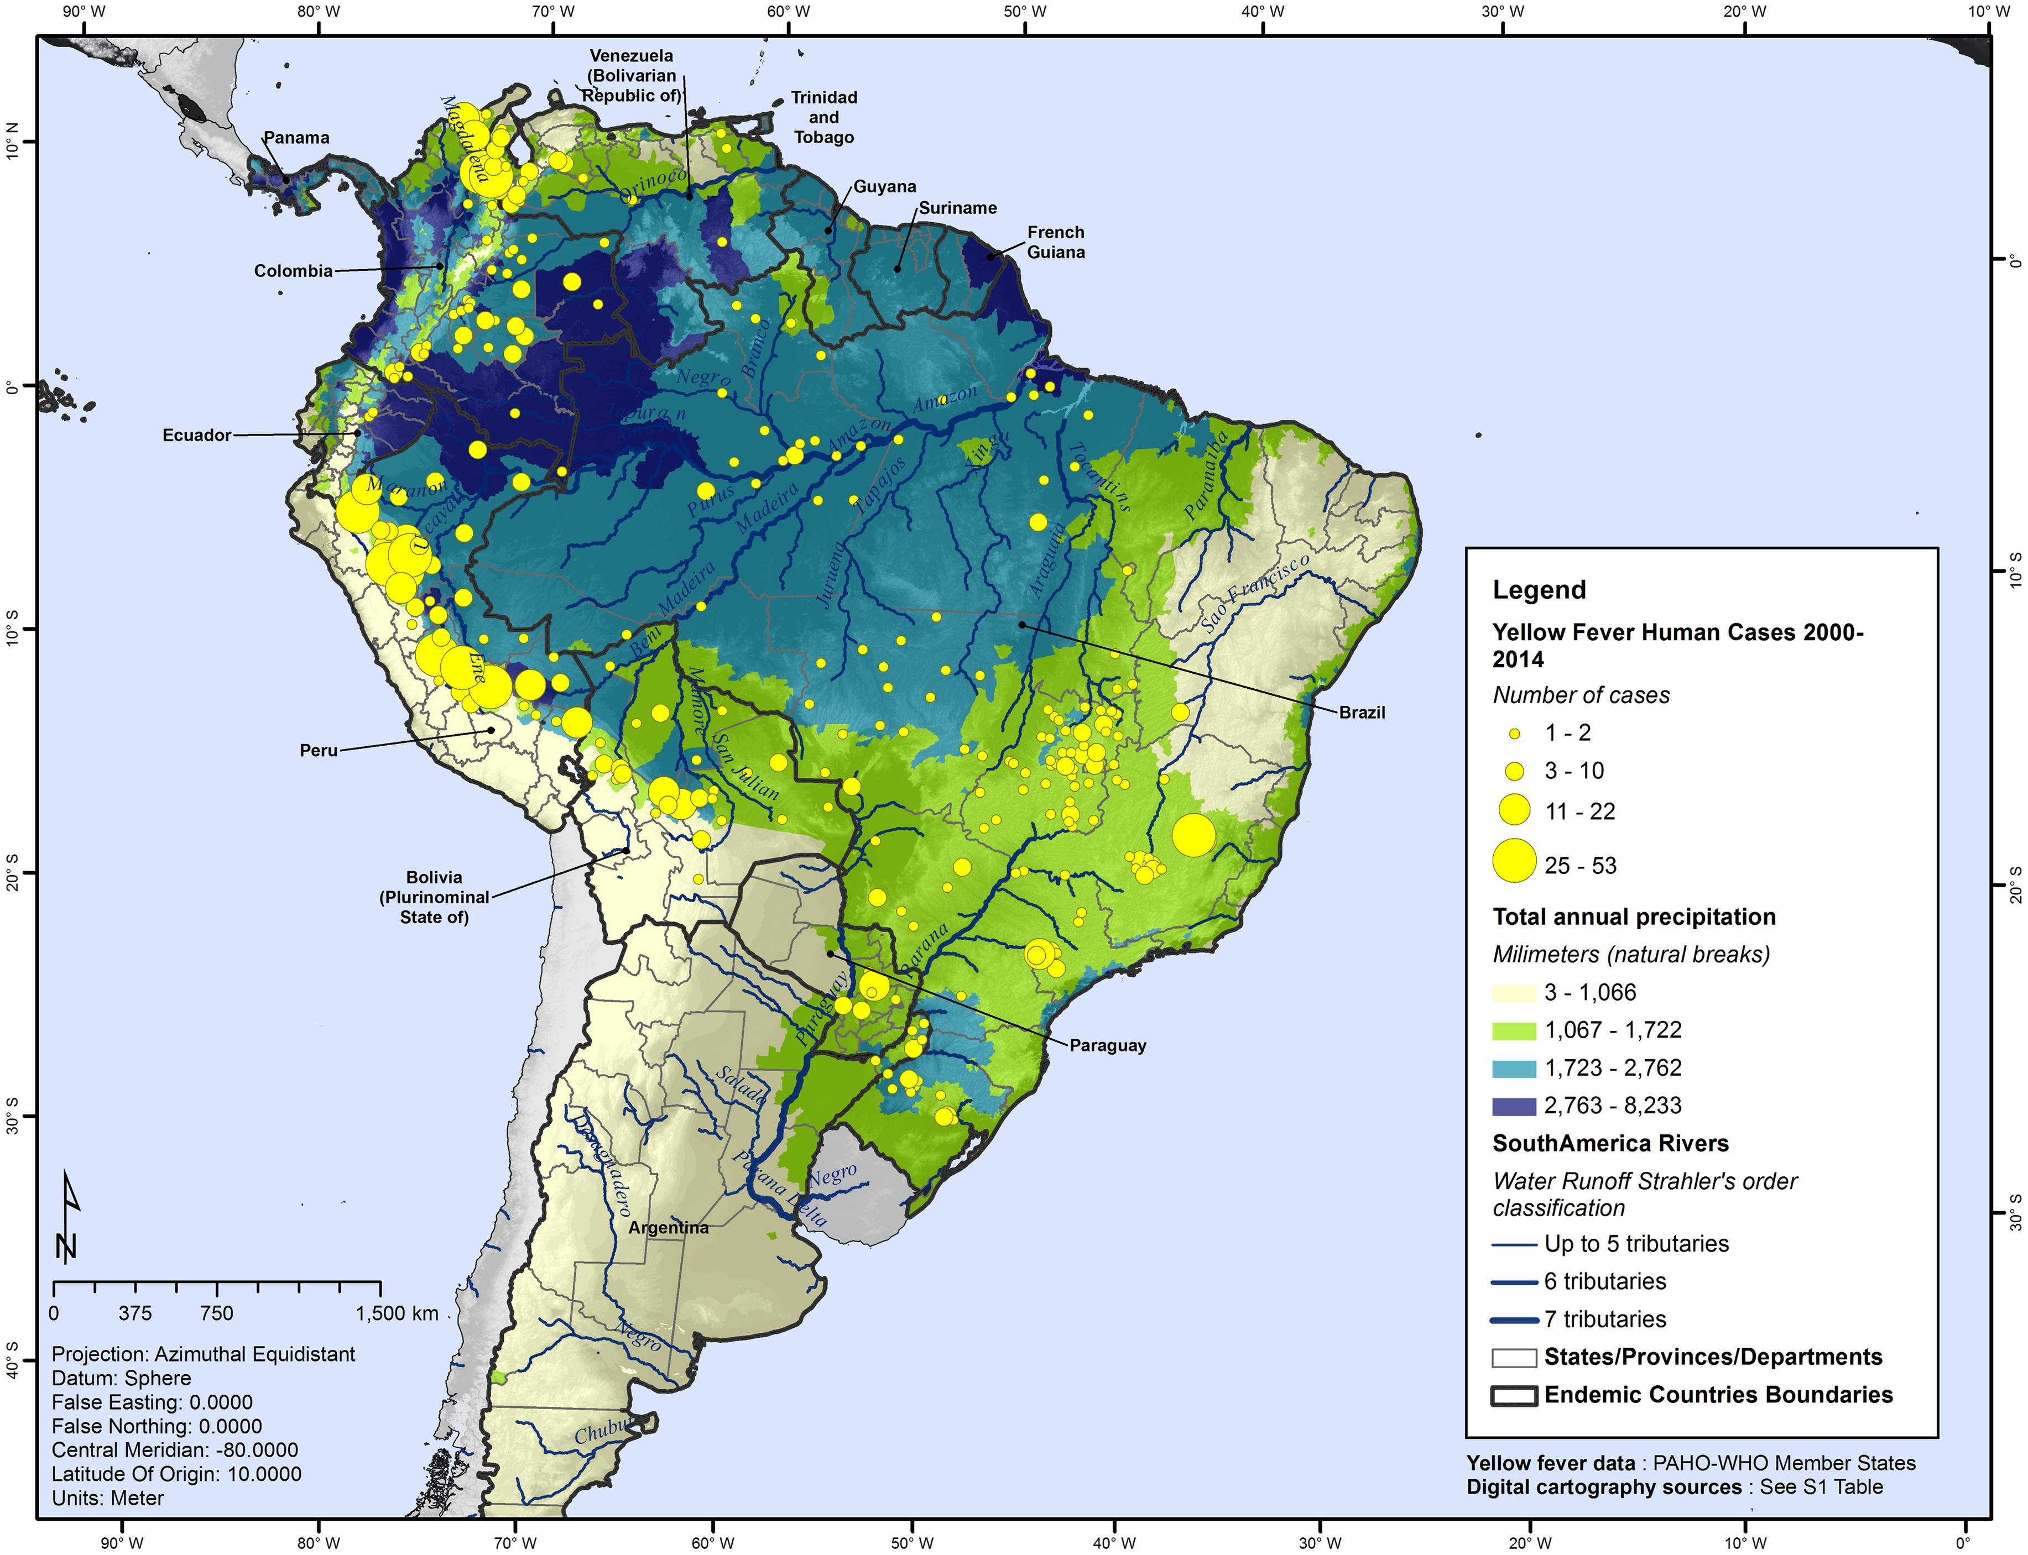
Statistical model question:
What is the relationship between the number of human cases and climatic variables?
Response variable: number of human yellow fever cases
Predictor variables: annual rainfall, temperature, humidity, human population size
Hamrick et al. 2017

Slide 3
Mechanistic model question:
How does variation in the extrinsic incubation period influence the probability of persistence for mosquito-borne zoonoses in the primate population?
extrinsic
incubation period
Mosquitoes
birth
S_{m}
exposure
E_{m}
I_{m}
death
death
death
transmission
transmission
Primates
birth
S_{p}
I_{p}
R_{p}
infection
recovery
death
death
death

Slide 4
Next steps
Incorporate a biologically-realistic primate birth pulse into the mechanistic model
Understand how the timing of the primate birth pulse influences persistence

